Slide 1
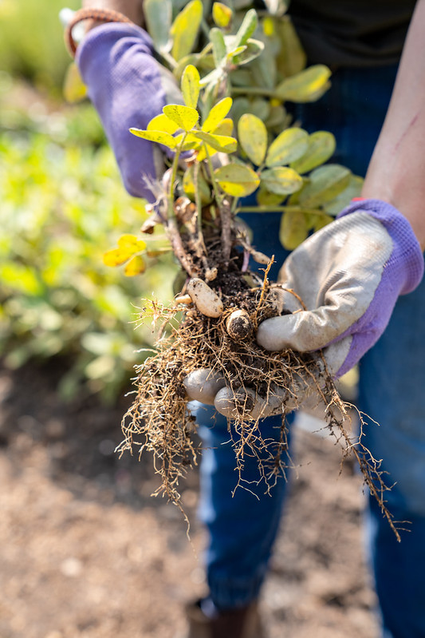
CWU Dining Services Food Waste Compost Project
Gretchen, Taylor, Solomon, Jillian, Sweta, Emma

Slide 2
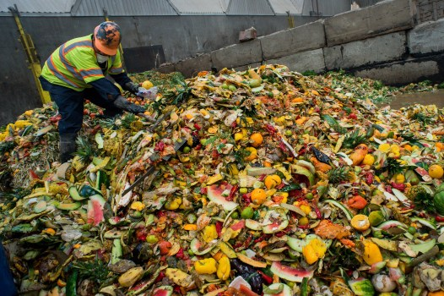
Food Waste
Photo by Sarah Reingewirtz, Sourced from Los Angeles Daily News
Notes:
Let me paint you a picture....
Food left to rot in landfills release methane, a greenhouse gas even more powerful than carbon dioxide. This gas contributes to 20% of the global greenhouse gas emissions
A decent food waste treatment system would be able to stop 11% of global greenhouse gas emissions (earth.org)
Photo pulled from Los Angeles Daily News (2018), Original Photo by Sarah Reingewirtz

Slide 3
Current Waste
Data was pulled from October 2023.
Average amount of food delivered per day was 534 lbs.
Limited data suggested 175lbs (vegetable clippings) wasted per day.
$1.75/lb/day which equals $305/day.
$9,455 thrown away in October 2023.
$9,455
~33%
Notes:
Data pulled from October 2023...October is the busiest month for Dining Services.
Important to note that the food waste data is only vegetable clippings collected from one day of measuring.
About a third is being wasted...

Slide 4
Money Lost
$75,744/year
Notes:
Over a period of 8 months the university will throw away $75,744/year.

Slide 5
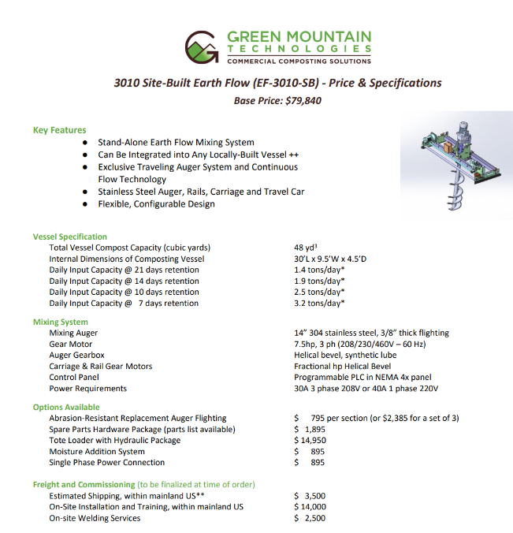
Solutions to Reducing Waste & Associated Costs
Purchasing of a Composter
EF3010
Base Price: $79,840
7 days retention = 3.2 tons/day
Highest volume of compost
Notes:
3.2 tons is 6400lbs

Slide 6
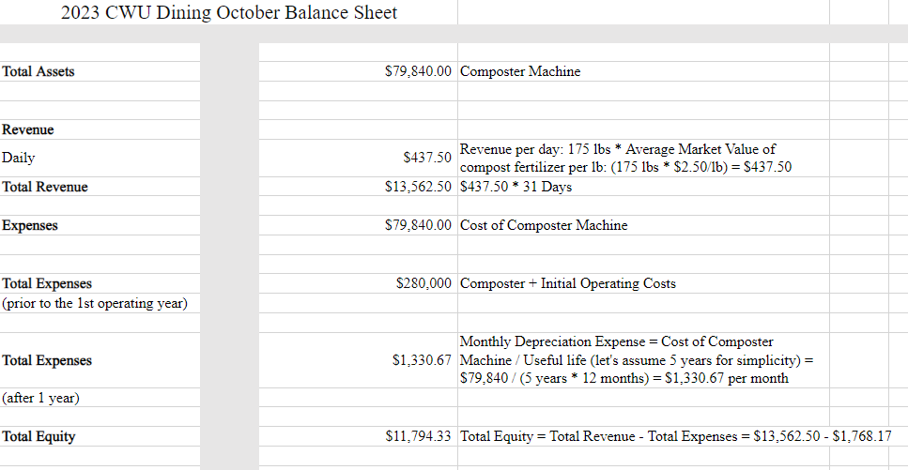
CWU Industrial Composter Financial Projections

Slide 7
Financial Sheet Review
Cost of Composter Machine = $79,840K
Market Value of compost fertilizer per lb = $2 to $ 5 per lb
Food Waste per Day= 175lbs
Revenue per year= $13,562
Cost of monthly expense of infrastructure
Packaging cost
Licensing cost
Energy cost
Employee cost
Insurance cost
Water cost
Technology cost
Notes:
Savings could pay for the composter within 2 years.

Slide 8
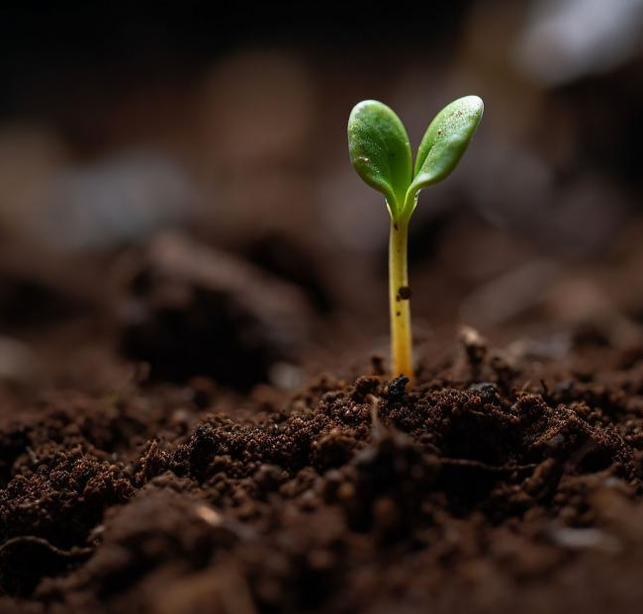
Conclusion
Initial cost of installation $280k
ROI breaks even 3 years if no revenue is generated.
A worthwhile investment.
Becoming a greener campus
Help reach the 25% waste reduction goal.
Combat Climate Change
Generate revenue for the university.
Fight the budget crisis.
Creative Commons Stock Photo

Slide 9
Q & A

Slide 10
References
Atkinson. D. (Feb 13, 2024). Charlies Produce SURC Usage - Oct. '23
Bousson. J. (Jan 26, 2024). SURC Invoice, Waste divison, SURC Refuse, EF3010 Site Build, EF Intermodal Cut Sheet.
Lewis, J. (2022, October 17). How does food waste affect the environment?. Earth.Org.
https://earth.org/how-does-food-waste-affect-the-environment/#:~:text=How%20Does%20Food%20Waste%20Affect%20the%20Environment%3F%201,Land%20...%204%204.%20Harm%20to%20Biodiversity%20
Organic compost fertilizer - concentrated strength (20 lbs. makes 60 lbs.) organic approved Non-GMO ESHUM20. The Home Depot. (n.d.).
https://www.homedepot.com/p/Organic-Compost-Fertilizer-Concentrated-Strength-20-lbs-Makes-60-lbs-Organic-Approved-Non-GMO-ESHUM20/314233848
Pinkerton, D. (2023, January 25). Compost facility planning: Composting Facility Cost Estimates: BioCycle %. BioCycle.
https://www.biocycle.net/compost-facility-planning-cost/
Reingewirtz, S. (n.d.). Puente Hills Material Recovery Facility. photograph, Puente Hills Material Recovery Facility.
https://www.dailynews.com/2018/02/20/heres-how-food-waste-at-uci-some-supermarkets-is-being-converted-into-electricity/

